Slide 1
Configure
Build & Deploy
Manage
Notes:
Run locally
One click to run all processes in my Procfile and append any environment variables
https://na1.salesforce.com/06930000001CGTH

Slide 2

1. Configure
Username
Password
Get API Key
API Key
Sdfadafafasasdfadfasdf…
Validate
Add SSH Key
Update SSH Key
Notes:
Validate – Attempt to login for the first time and then store the API Key temporarily in either the workspace or some file that can be used for subsequent operations.
Do we want to support API Key only login instead of them giving up their password?
Do we want to support multiple account management?
John,Ryan – Multi logins is really not great use case for non-Heroku
SSH keys – May not be required if HTTP Git
Most developers might have a “Developer account” and a possible “work account” which might need multi-account management.
Use default keys, Key Management is not something an average developer would probably not know.
Advanced developers should be able to change their keys
Streamline Key generation..TBD

Slide 3
2. Build and Deploy
Import an existing Heroku app to my workspace
(or)
Create a new App (from templates)
(or)
Deploy an existing app into Heroku

Slide 4
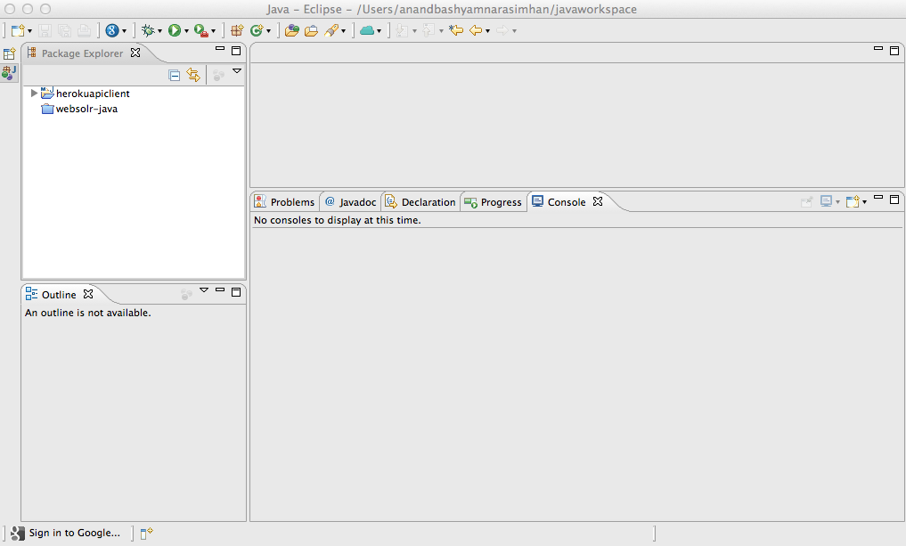
A. Importing an app
My Heroku Apps
Import
View
Destroy
Rename
My Play App
My Famous App
Hello World
Notes:
Import would do the following:
Do a “git clone” of the app’s git Repo url
SSH Key setup is a prequisite
Need to leverage any eGit/jGit plugins that the IDEs already have
Create the IDE specific files (.project , .classpath for Eclipse)
Possibly have a Heroku specific tag on the .project that identifies the “app name” (do we read into the remote repo URL like what the command line does today?)

Slide 5
A. Importing an Heroku app
myplayapp
My Heroku Apps
Import
View
Destroy
Rename
My Play App
My Famous App
Hello World
Notes:
Somehow inject this process into the “import from Git/Version control” flow is possible

Slide 6
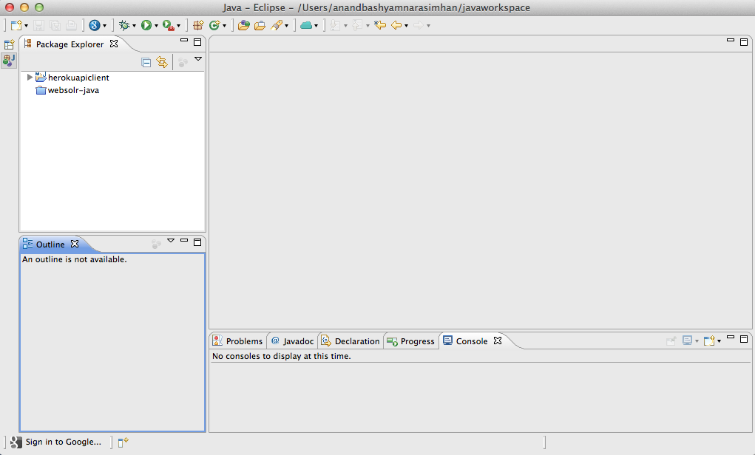
B. Create from Template
News and RSS feeds from dev center?
Java
New Play App
Spring MVC App
Tomcat 7 Web app
Etc.
Addons
Scala
Scala/SBT Finagle Web App
Scala + Akka app
Platform updates?
NodeJS
Simple NodeJS
Tweets / Discussion board snapshots?
Notes:
Jesper feedback:
Isn’t this the same as “git clone”. Should we do that instead of wrapping that in a separate plugin.
Is there a concern around that the application is “heroku specific”.
It could embed java.herokuapp.com and have the end-user refresh and import the app using Option A
Could be API based or simply mashup the web ui
What about “New -> Project -> Heroku” : Possible flow to the same page.

Slide 7

B. Create from Template
News and RSS feeds from dev center?
Java
New Spring MVC App
Application Name
New Play App
Spring MVC App
Tomcat 7 Web app
Etc.
Addons
Create
Scala
Scala/SBT Finagle Web App
Scala + Akka app
Platform updates?
NodeJS
Simple NodeJS
Tweets / Discussion board snapshots?
Notes:
Do we make the container selection something that’s part of this wizard or do we have separate Templates for each of these? This selection is only relevant for non-Play apps.
Possibly Loose this screen.
Pat – Just default the container for newbies. Probably an “Advanced tab” that allows them to choose a different container.

Slide 8
C. Deploy to Heroku
myspringmvcapp
Open Project
…
Heroku >
Deploy to Heroku
Notes:
This is essentially “Run as Heroku” not “deploy to Heroku”.
The app should have all key required components to run the app on Heroku which includes:
Pom.xml
Project structure
Procfile
.gitignore
Git setup including git remote pointing to the app’sgit repo URL

Slide 9
C. Deploy to Heroku
myspringmvcapp
Open Project
…
Heroku >
Deploy to Heroku
New Spring MVC App
Application Name
My Heroku Apps
Create
Cancel
My Play App
My Famous App
Hello World
Notes:
Do we make the container selection something that’s part of this wizard or do we have separate Templates for each of these? This selection is only relevant for non-Play apps.
Jesper:
Run-As does not make sense.
John,Ryan – Run as does not make sense.
Possible risk of developer trying to deploy arbitrary app
Context sensitive and should not allow “deploy” if “Procfile” is not found
A wizard (key value pair) for the Procfile

Slide 10
C. Deploy to Heroku
myspringmvcapp
Open Project
…
Heroku >
Deploy to Heroku
New Spring MVC App
Application Name
myspringmvcapp
My Heroku Apps
Create
Cancel
My Play App
My Famous App
Hello World
myspringmvcapp
Notes:
Do we make the container selection something that’s part of this wizard or do we have separate Templates for each of these? This selection is only relevant for non-Play apps.

Slide 11
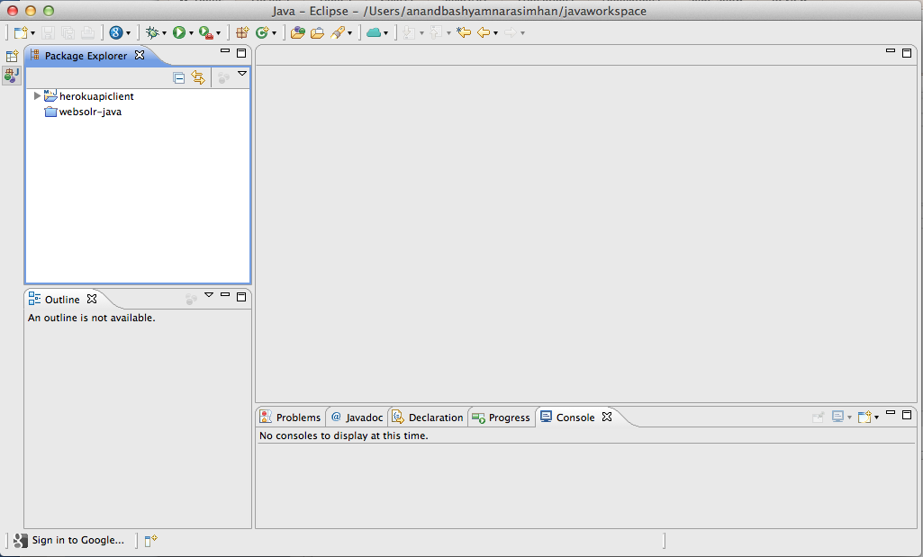
3. Manage: App Info View
My Play App
Git Repo Url
App Web Url
Repository Size
Domain Name
Dynos
http://myplayapp.herokuapp.com
Collaborators
Environment Configuration
Addons
My Heroku Apps
Releases
My Play App
My Famous App
Hello World
Notes:
Double clicking on the app provides a “Read only view of the app”. View should display the following:
Git Repo Url
App Web Url (Probably a View in Browser link that takes them directly to the app)
Repository Size
Domain Name
Dynos – Web and non web (Not sure if we can easily distinguish this always)
Additional sections:
Collaborators
Add Collaborators button to add additional collaborators
Make a collaborator an owner
Environment Configuration
CRUD on Environment Configuration
Addons
Manage button should take them to the “Addons.heroku.com” page on a browser
Releases
Revert to a Release (???)

Slide 12
3. Manage: My Processes
My Heroku Apps
My Play App
Web (Up, 10 m)
Worker (Down)
Worker 2 (Idle,2 m)
My Famous App
Hello World
Restart
Logs
Notes:
Expanding an App in the App view should provide a UI friendly view of “heroku ps”
All process types along with status (through indicators)

Slide 13
3. Manage: Refresh my apps
My Heroku Apps
Refresh
My Play App
My Famous App
Hello World

Slide 14
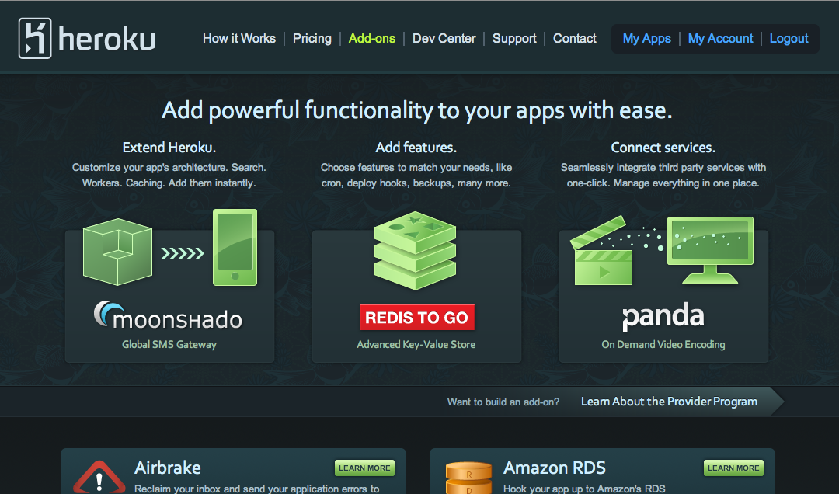
3. Manage: Addons
My Heroku Apps
Restart
Logs
Addons
My Play App
Web (Up, 10 m)
Worker (Down)
Worker 2 (Idle,2 m)
My Famous App
Hello World
Notes:
Expanding an App in the App view should provide a UI friendly view of “heroku ps”
All process types along with status (through indicators)

